Slide 1

Department of Computer Science and Engineering
AI-Powered Legal Document Analysis System:
Clause Detection, Category-Level Risk Prioritization
and Plain-Language Explanation on CUAD
Submitted by
Group ID: P25301051
Jerin Aktar — 22101279
Afnan Mazumdar — 24141229
Shoyeb Hasan Sayem — 22101386
Supervisor
Utsha Kumar Roy
Department of Computer Science and Engineering
Brac University · September 2026
Notes:
Three-model pipeline on CUAD. Most of what we report is negative, and we present those results as the contribution.

Slide 2
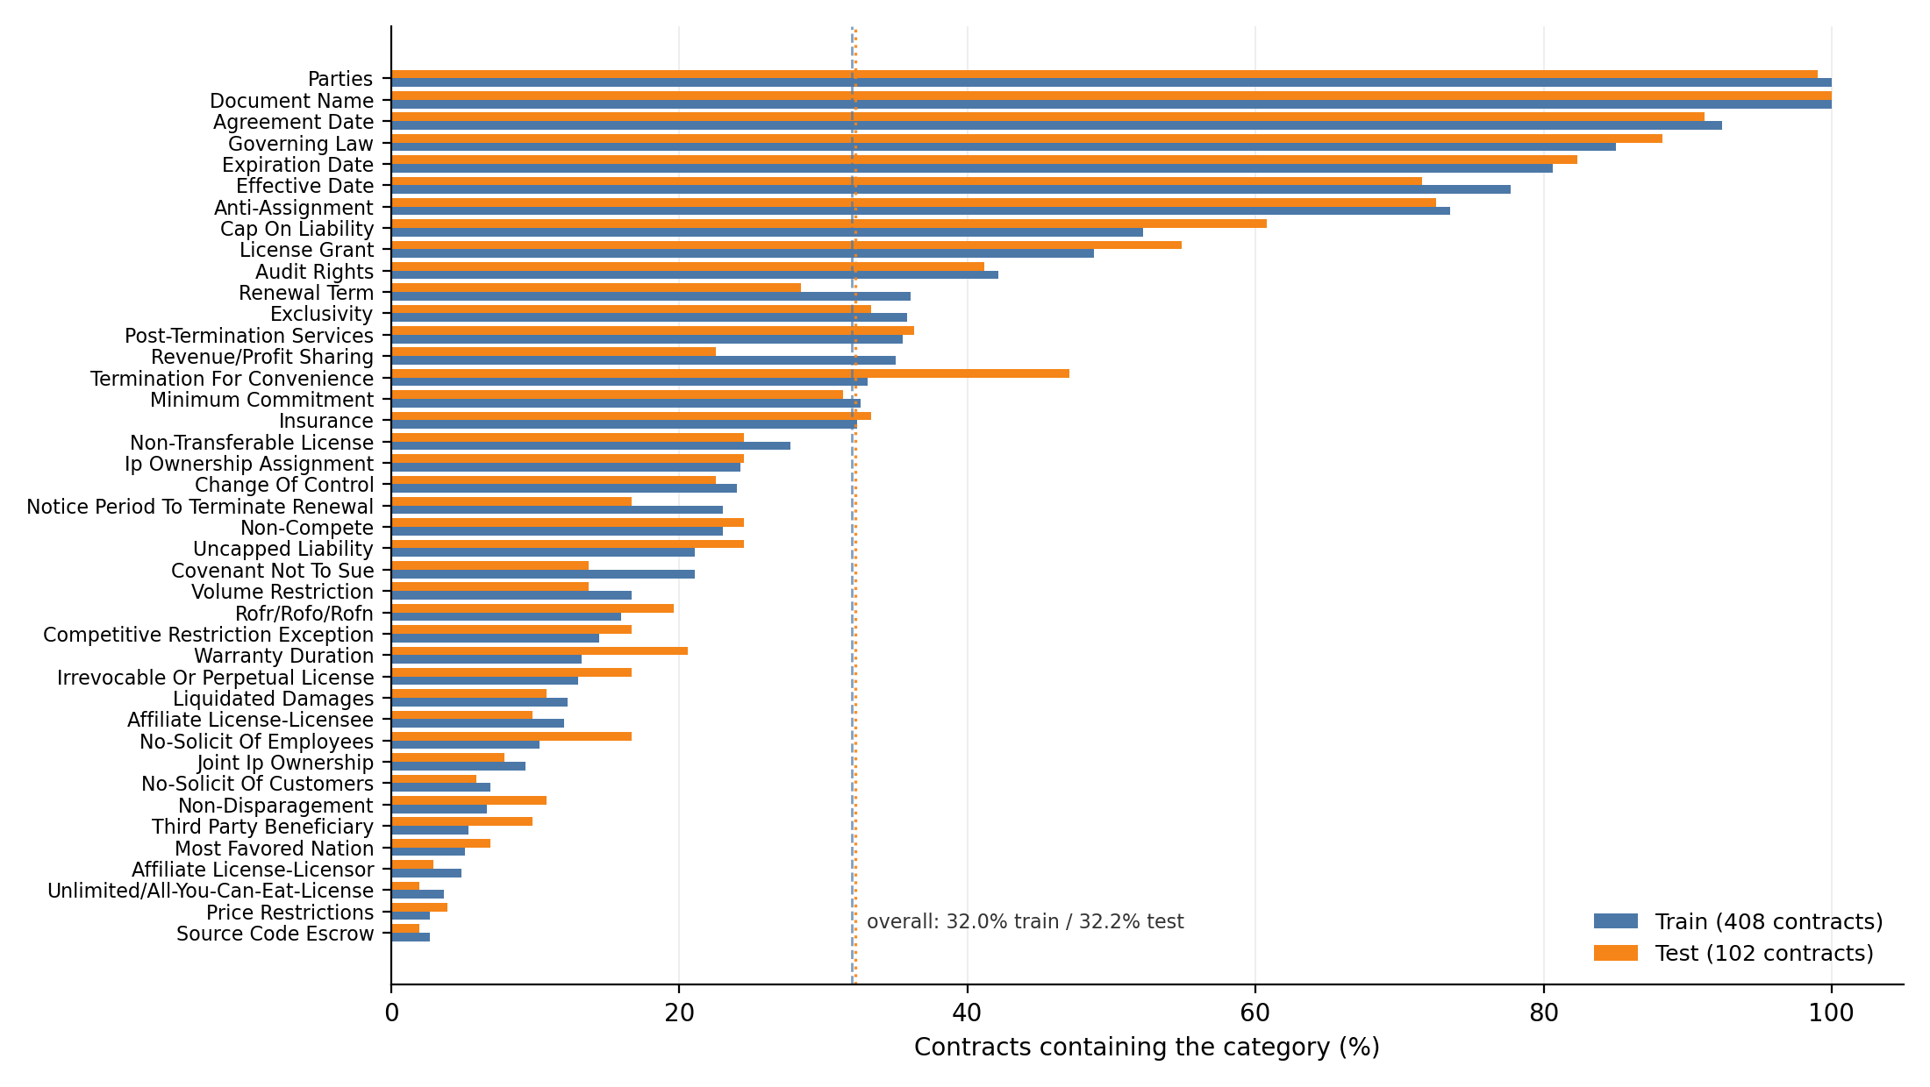
CHAPTERS 1 & 3
The problem, and the data
Contracts are long, the clauses that matter are short, and 510 contracts is the whole dataset
33,000
196
16×
41
Contract-level 80/20 split
408 train / 102 test, seed 42, reused by all three models. No clause from a training contract can reach the test set.
median chars
median clause
over the window
categories
Severe imbalance
Positive rates run 100% to 2.5%. Five categories have ≤7 positive test contracts and score 0.000 F1.
It cannot be grown
CUAD's annotation reportedly cost ≈$2M of attorney time. Transfer learning is mandatory and overfitting is the main enemy.
Per-category positive rate, train vs test (Fig. 3.1)

Slide 3
CHAPTER 4
The pipeline, and how it reads a contract
Four stages — with a failure point at every boundary
Contract
1 Presence
2 Span
3 Risk
4 Explanation
raw text
›
TF–IDF + windowed BERT
›
DistilBERT-QA
›
per-category lookup
›
FLAN-T5 template
22.0% lost
56.3% lost
0% — lookup
30% wrong template
the clause — 196 chars
Removes the recall ceiling
window 1
0.04
Windows overlap by 500 chars — more than the median clause — so nothing falls between them.
window 2
0.11
max = 0.91
→ present
window 3
0.07
window 4
0.91
Costs precision
⋮ 22 windows for a median contract, 226 for the longest
One spurious window anywhere flips the whole contract positive. Long contracts false-positive structurally.
Measured before training: question-guided retrieval caps recall at 64.0% — below what the baseline already achieves — so retrieval was dropped without spending a training run on it.

Slide 4
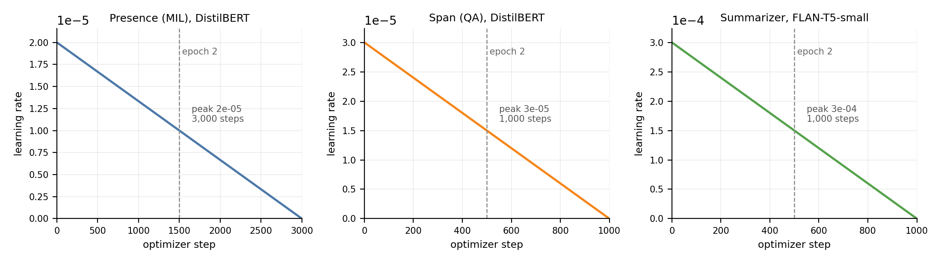
CHAPTERS 5 & 6
How we trained, and how we test
Three models on one laptop; one held-out split reused by all of them
Presence
DistilBERT · 24,000 of 53,662 windows · batch 16 · LR 2e-5
≈49 min
What was held out
Span
DistilBERT-QA · 8,000 of 11,156 · 320 tokens · LR 3e-5
≈23 min
Presence: 5% of TRAINING windows. Span and the deployed summarizer: nothing. No hyperparameter was ever tuned — every value is a published default.
Explanation
FLAN-T5-small · 4,000 of 11,156 · CPU · LR 3e-4
≈8 min
One thing we got wrong
The exploratory summarizer run monitored loss on 300 TEST clauses. It selected no checkpoint, and the deployed model was rebuilt without it.
How we test
Linear decay, no warmup (Fig. 5.1)
102 unseen contracts · 4,182 presence decisions · 2,667 span windows · 150 clauses. Bootstrap resamples CONTRACTS, not cells, because 41 decisions move together.
Apple M4, 16 GB, Metal — no CUDA. DeBERTa-v3 produced NaN gradients on MPS, so backbones were downsized; gradient clipping fires on 98.4% of steps.

Slide 5
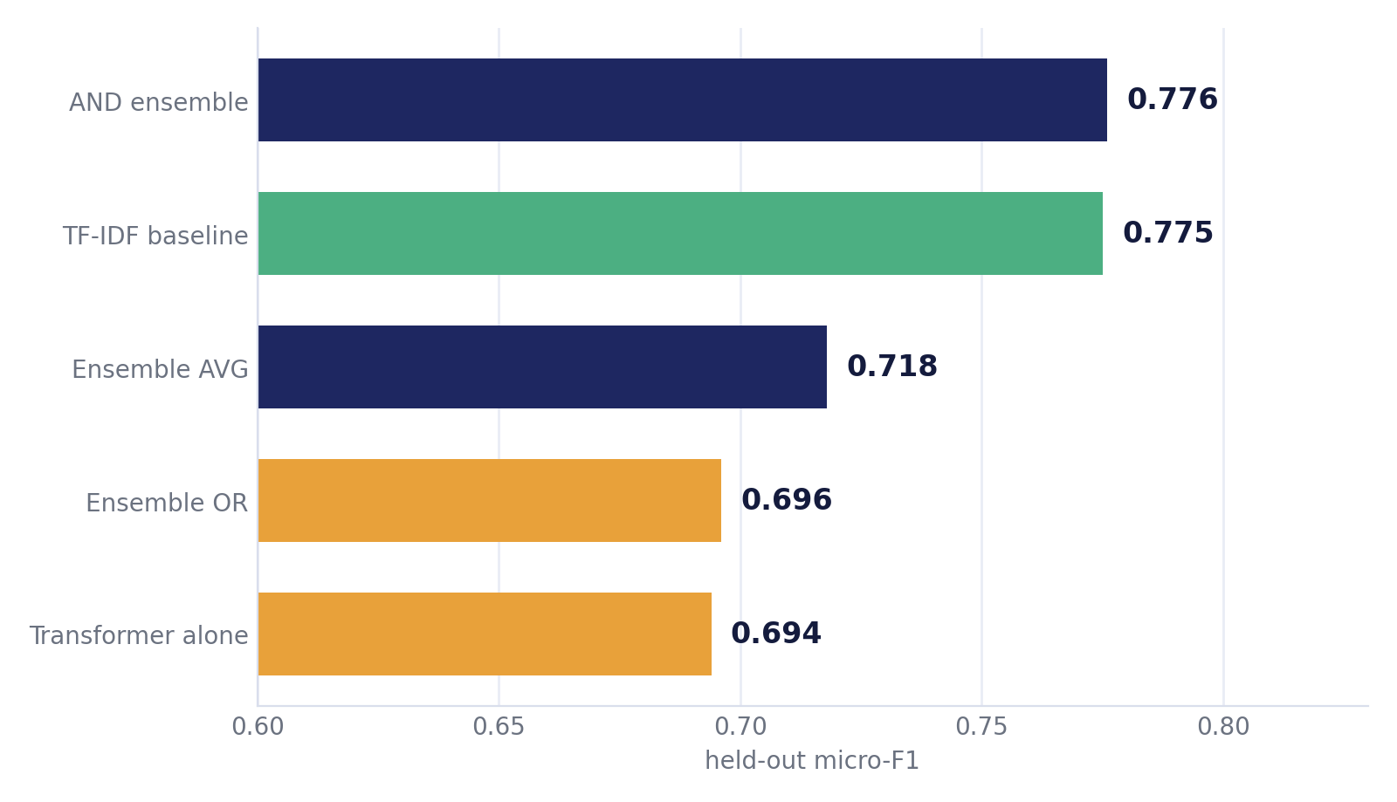
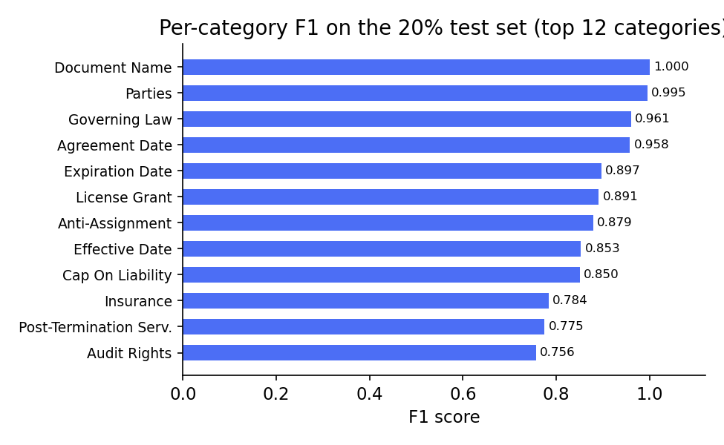
CHAPTER 6
RQ1: the transformer loses to a bag of words
Held-out micro-F1 over 4,182 (contract, category) decisions
What we stand behind
The lexical baseline beats the windowed transformer by +0.081 — and it survives every control we could construct.
What we withdrew
The ensemble's +0.0014 lead is not a result: bootstrap, seed variance and split variance all exceed it.
Strong at one end, absent at the other
Per-category F1, twelve
strongest categories (Fig. 6.3)
Document Name 1.000, Parties 0.995, Governing Law 0.961. Five categories with ≤7 test positives score 0.000 — micro-F1 0.776 against macro-F1 0.572.

Slide 6
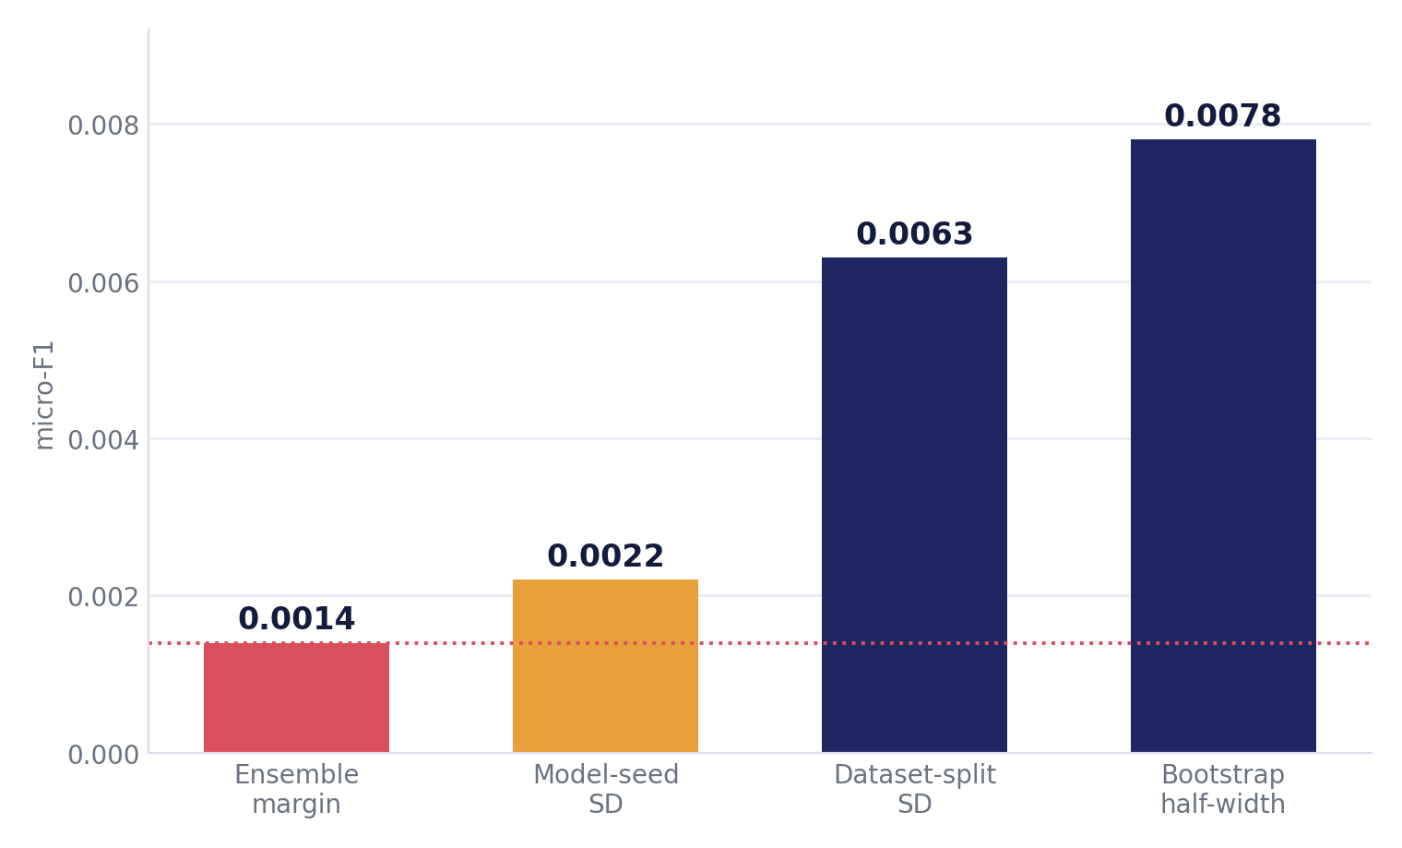
CHAPTER 6
We ranked a leaderboard by noise
Every alternative explanation for the transformer's defeat, tested one at a time
Undertrained? all 53,662 windows → −0.0004
Unlucky seed? 3 seeds → the gap is 9.5 SD
Wrong pooling? 6 rules → none reach the baseline
Bad threshold? explains 0.056 — a real caveat
Why keep the ensemble at all?
Removing it changes nothing measurably — which is itself a finding. We keep it for the balanced error profile and 4× lower seed variance.
The conclusion
Dataset-split variance (SD 0.0063 over 20 refits) is the largest of the three and the one most often omitted — reseeding holds the test set fixed and cannot see it.
The transformer loses. It is not a budget, seed or aggregation artefact — though part of the gap is an operating point nobody chose.

Slide 7
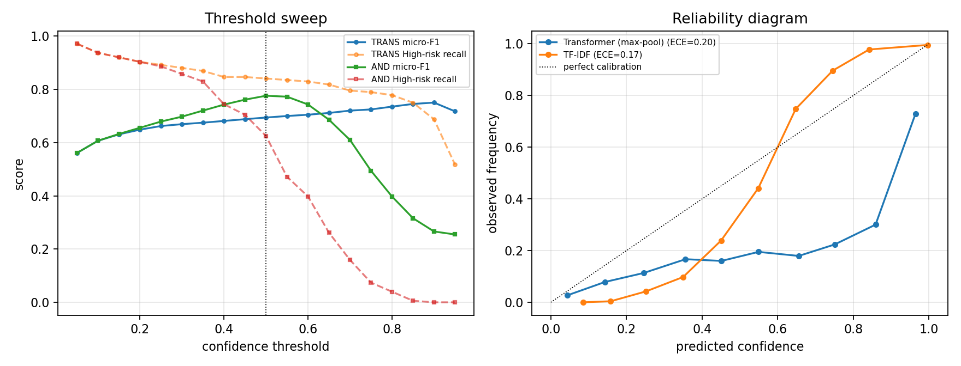
PROBLEM
The threshold, and what the confidence means
Both measured only after the fact — and both turned out to matter
0.5 is the softmax default
Swept, the transformer reaches 0.750 instead of 0.694. Part of its deficit is an un-chosen operating point.
ECE 0.201
Scores above 0.9 mean the clause is present about 73% of the time — and the app shows this as a confidence bar.
Threshold sweep and reliability diagram (Fig. 6.4)
What we would do about it
We do not adopt the swept threshold — choosing it on the test set is exactly the tuning our protocol certifies against. The fix is concrete: carve a validation split from the 408 training contracts, select the threshold there, and fit a Platt scaling map on the same split. Neither costs compute, and neither touches test data.
The presence model also over-fires by design: precision 0.562 at threshold 0.5, and more training data moved recall up (0.908 → 0.927) while precision fell — a maximum over ~35 windows is 35 chances to be wrong.

Slide 8
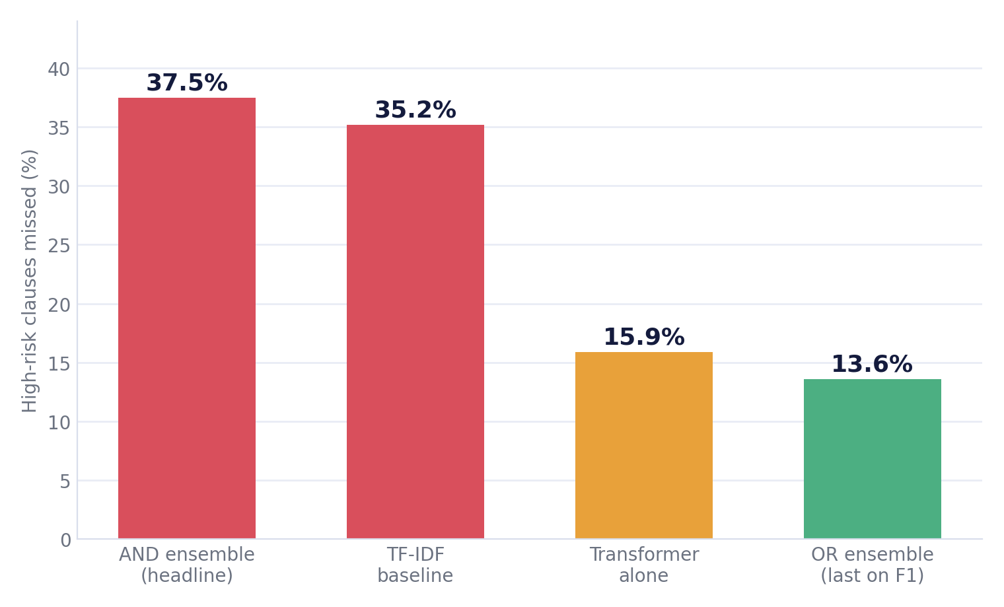
PROBLEM
The metric disagrees with the purpose
Percentage of HIGH-RISK clauses missed, by configuration
The configuration that wins on micro-F1 is the worst one for the clauses that matter most.
176 High-risk gold clauses in 102 contracts
AND finds 110 and loses 66; OR finds 152 and loses 24
Choosing on micro-F1 costs a signer 42 High-risk clauses
Two thirds of micro-F1's mass is dates and party names
And on the rare tail
The AND rule adds nothing at all: F1 0.343 either way, with detections cut from 35 of 70 to 17 of 70.
We report this as a diagnosis, not a retuning — selecting the OR rule after seeing these test-set results would be test-set selection.

Slide 9
PROBLEM
The span model is handed the wrong window
Training taught it a layout that inference never provides
At training time
At inference time
answer
always ≈150 chars in — every single example
answer anywhere — or not in the window at all
31.7%
39.7%
0.763→0.386
0
selected window has no clause in it
success even when the window IS right
token-F1, isolated → in the pipeline
ways to say “not here”
Two causes, both fixable without a bigger model
Max-pooling was trained to detect, not to locate — we reused a detector as a locator. And the focus window was re-centred on the answer at training time only, narrowing the distribution the model can read. SQuAD v2-style abstention and varied answer offsets address them directly.

Slide 10
PROBLEM
The summarizer became a 41-way classifier
We wrote all 41 target sentences ourselves — and that one decision is what turned generation into classification
clause text
“any attempted assignment … will be void”
Anti-Assignment template
correct 70%
FLAN-T5 learns to
recognise the CATEGORY
›
›
Cap on Liability template
ROFR template
wrong 30%
⋮ 41 pre-written templates in total
0.775 → 0.116
0.115
100%
ROUGE-L: our templates → clause-specific references
the template with NO model at all
of outputs are a template, copied verbatim
Why this is worse than a low score
It cannot hallucinate — it can only emit one of 41 human-written sentences. But when it picks the wrong one the output is fluent, confident, and about a different provision entirely, which is undetectable from the output alone. Fine-tuning also made it worse: zero-shot scores 0.299 against the same references.

Slide 11
THE HEADLINE
End to end, 78.3% of clauses are lost
The number that describes what a user actually experiences
1,348 gold clauses
↓ −296 clauses (22.0%)
1,052 survive presence detection
↓ −759 clauses (56.3%)
293 survive span extraction
21.7%
survive all three stages
95% CI [19.6%, 23.9%]
Multiplying the component scores predicts ≈64%. The pipeline delivers a third of it — the selected window contains the clause only 68.3% of the time, and extraction then succeeds 39.7% of the time.

Slide 12
FINDINGS
What we found
Four findings survived every check; five beliefs we started with did not
Findings that held
Beliefs that did not survive
Lexical evidence over the whole document beats windowed semantic evidence
“The ensemble beats the baseline”
+0.0014 — smaller than bootstrap, seed and split noise alike
+0.081, surviving budget, seed, pooling and threshold controls
“The summarizer summarizes”
Measure a feasibility ceiling before training
0.775 → 0.116; a lookup table scores the same
a 60-second retrieval check (64%) killed an architecture at zero cost
“Component scores describe the system”
≈64% predicted, 21.7% delivered
Agreement between models damps seed variance
the ensemble is 4× less seed-sensitive than the transformer inside it
“A Longformer will not fit in memory”
it does, at batch 1 — 14.7 GB of 16. Time is the barrier
Span extraction genuinely works — given the right window
“Max-pooling is the ceiling”
token-F1 0.763, CI [0.740, 0.782]
six rules tested; it is a secondary factor, not the cause

Slide 13
LACKINGS
What we discovered was missing
Not known at the start — each was found by running the experiment
CUAD has no plain-English targets at all
So we wrote 41 ourselves — and that decision is precisely what collapsed the summarizer into a classifier.
No published risk-severity model to build on
Legal NLP treats importance as category membership, not danger to a party. The severity scale was built from scratch.
The rare tail is effectively few-shot
11–42 positive training contracts for the bottom ten categories. Five score 0.000 and no model learns them at this size.
Some rare-tail “errors” are annotation disagreements
A clause labelled Third Party Beneficiary reads as an assignment clause — our 0.000 scores mix model failure with label ceiling.

Slide 14
LACKINGS
What this work still lacks
Gaps in the evidence, stated so an examiner does not have to find them
We never carved a validation split
So the threshold cannot be chosen and the confidence cannot be calibrated without redrawing the protocol.
Risk is assigned per category, not per clause
The taxonomy cannot tell a $10,000 liability cap from a $10,000,000 one — the specific wording is not modelled.
One dataset, one jurisdiction
510 US contracts from SEC filings. No Bangladeshi contract, no consumer or employment agreement, no other language.
Nobody reports end-to-end survival
We had no published figure to compare our 21.7% against — which is also why the number was worth measuring.

Slide 15
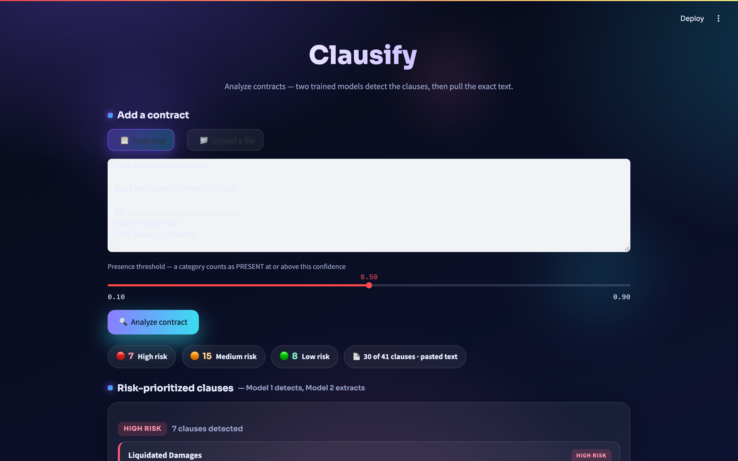
CHAPTER 7
Clausify, and how far we came
A deployed prototype — with every measured limit stated on the interface
Latency, measured
Confidence ≠ probability
Median contract 27.1 s, worst case 32.4 s on CPU.
ECE 0.201 — a nearly full bar means ≈73%.
Long contracts are truncated
Privacy holds — locally
30-window cap = 45,500 chars; 38.4% of CUAD exceeds it.
Read into memory, never written to disk or logged.
The risk-prioritized report (Fig. 7.2)
What exists at the end of it
3 trained models
11 experiments
presence, span and explanation, reproducible from saved checkpoints
4 controls, rare tail, risk-weighted, threshold, calibration, ablation, end-to-end, cost benchmark
101 numbers verified
A deployed prototype
84 reported figures and 17 derived comparisons, checked mechanically against source data
running locally, with its measured limitations stated in the interface

Slide 16
FUTURE WORK
Future work I — no compute required
The four highest-value things left, and none of them needs a GPU
Carve a validation split
Hold out part of the 408 training contracts, then select the threshold and fit a calibration map there. Fixes two problems at once.
1
Observe someone using Clausify
5–10 participants, watching for over-trust in the quoted text and the confidence bar — both of which we have shown are unwarranted.
2
Select on the objective that matters
Define a risk-weighted criterion, choose the ensemble rule on a validation split, then report once on test.
3
Calibrate the confidence score
Platt scaling or isotonic regression. Fixes ECE 0.201 with no retraining at all.
4

Slide 17
FUTURE WORK
Future work II — modelling
Each one targets a specific failure from the problems section
Let the span model abstain
SQuAD v2-style unanswerable examples, and training on varied answer offsets rather than a fixed 150-character position.
5
A locator trained for locating
Replace the max-pool argmax with a model actually asked which window holds the clause — fixes the 31.7% wrong-window rate.
6
Clause-diverse summarization targets
Scale the 150-clause pilot to a few thousand references, so the task stops being 41-way classification.
7
Cross-validation, and contracts beyond CUAD
Split SD 0.0063 is the largest uncertainty we measured; three locally sourced agreements would say more than further CUAD tuning.
8

